Slide 1
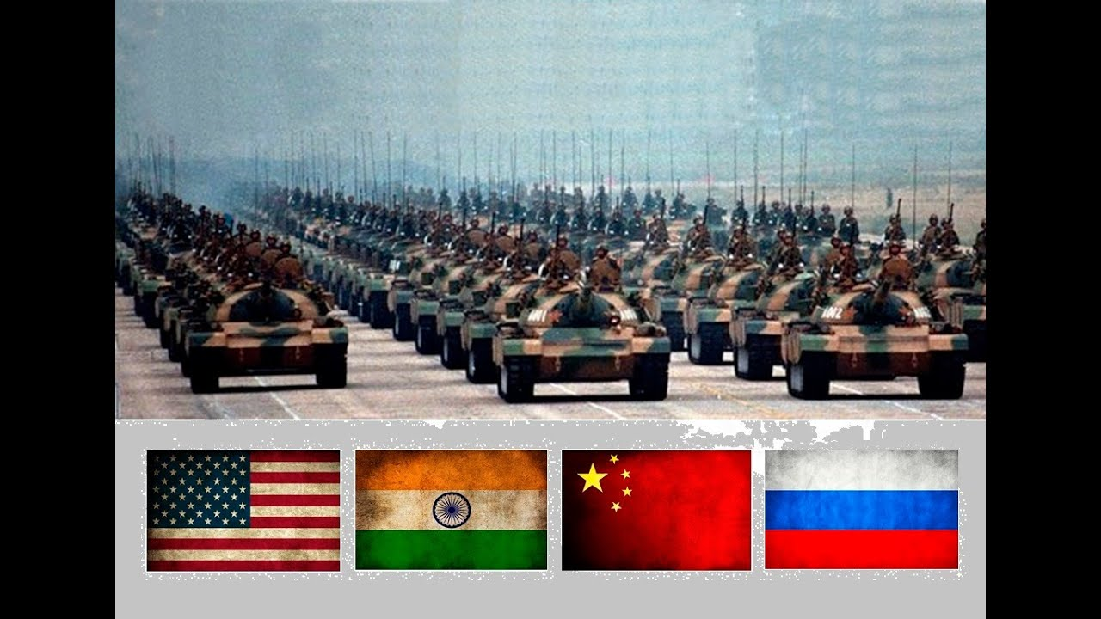
The Role of Big Powers in Bangladesh Liberation War
USA
USSR
CHINA
INDIA

Slide 2
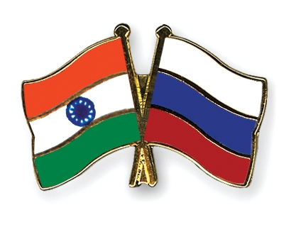
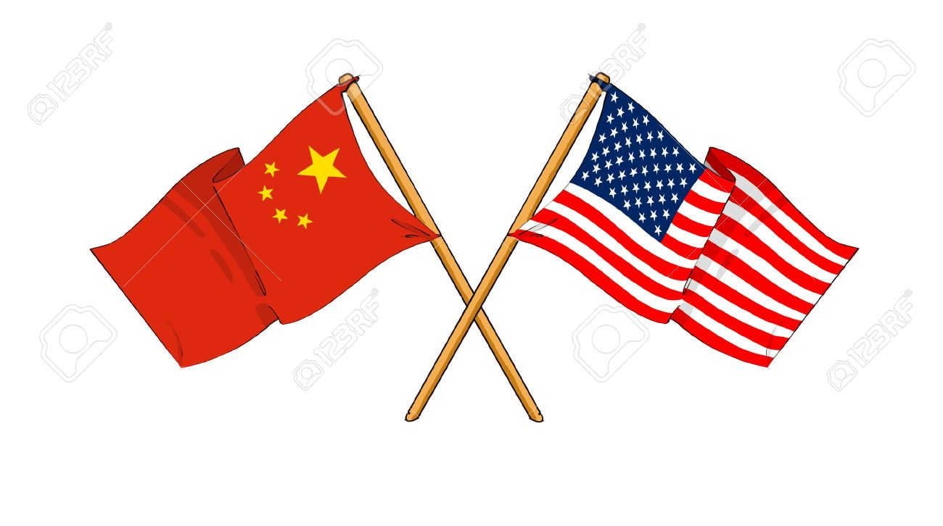
Two Blocs
On Against of Liberation
On Behalf of Liberation

Slide 3
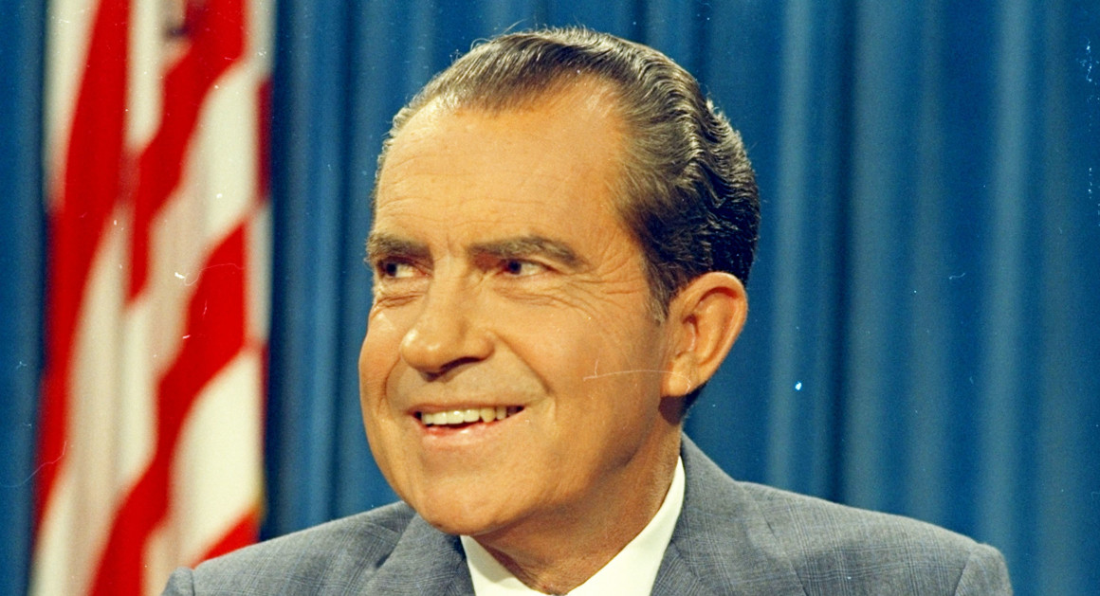
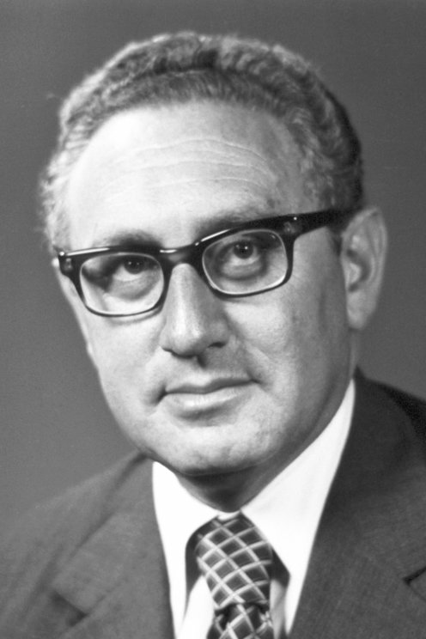
USA
Executives during 1971
PRESIDENT OF UNITED STATES OF AMERICA
US SECRETARY OF STATE
Richard Nixon
Henry Kissinger

Slide 4
Why USA adopted Pakistan Friendly Policy
Membership of Pakistan to SENTO and SEATO
Pakistan’s good ties with Islamic Countries of Middle East
Pakistan played a pivotal role in the normalization of relation of USA with China
Nixon’s Personal Outlook to India
To make Pakistan as a strong nation against Soviet-India Bloc

Slide 5
First Phase of US Policy
(March to July)
Neutrality- In the onset of war, US adopted the policy of neutrality (strategic) and termed the crisis as ‘the internal matter of Pakistan’.
US Arms Supplies for Pakistan-
US ambassador to Delhi, Mr. Kenneth Keating extremely criticized the US policy of ‘neutrality’ and ‘internal matter’ and postulated that it no longer be an internal matter and the world’s mustn’t neglect the matter in the excuse of ‘internal matter’.
On 7th May, US authority, forced by domestic and international opinions, decided not to supply arms and financial assistance anymore and on 12 June Nixon demanded political solution for the crisis.
But media reported that Arms supply was continued and US Foreign Ministry replied that ‘contract is signed before 25th March. Within June US provided with 4.3 million dollar worth arms to Pakistan which was used to execute the Bengalis.
‘আমেরিকা সর্প হয়ে দংশন করে, ওঝা হয়ে ঝাড়ে’— Motia Chy. 19 June, 2017. US administration assisted the refugees of Bangladesh in India with 30 lac dollar. Why??????

Slide 6
Second Phase of US Policy
( July-October)
US Recognition to PRC- American President Nixon entered into negotiations with Communist Chairman Mao to resist USSR, initially through a secret 1971 trip undertaken by Henry Kissinger to visit Zhou En lai. On 25 October 1971, Albania's motion to recognize the People's Republic of China as the sole legal China was passed as General Assembly Resolution 2758. It was supported by most of the communist states (including the Soviet Union) and non-aligned countries (such as India), but also by some American allies such as the United Kingdom and France. US became more active in supporting Pakistan by this time.
Political Solution (Cease Fire)- USA was searching for a political solution through saving the unity of Pakistan. But they failed to reach in any decisive role in the second phase.

Slide 7
Third Phase of US Policy
(September- 3rd December)
By this time, USA had showed strong fascination for Pakistan
US embassy tried to compromise with Kolkata based AL leaders by freeing Sheikh Mujib from Pakistan and forced Pakistan Govt. to address the ‘East Pakistan’ crisis in a moderate way as well.
Although both Mujibnagar and India refused to go any solution except the liberation of Bangladesh.
Even on her US tour, Indira Gandhi requested to cease pro-Pakistan policy of USA.

Slide 8
Fourth Phase of US Policy
(December 1971)
Tilt Policy- Nixon instructed his secretary of state to extend diplomatic support in full extent. This policy is termed as ‘tilt policy’. USA stopped the aid to India temporarily amount of 86.6 million dollar. At the same time USA was continuously pressurized India through UN. Permanent representative to UN Mr. George Bush marked India as first ‘attacker’ and Kissinger in a press conference at white house marked India as ‘attacker’ and ‘traitor’.
Military Means (Task Force 74) - A task force was sent to Bay of Bengal with 8 ships having nuclear weapons known as ‘task force 74’. On 8th January-1972, taskforce 74 left Indian ocean.
Diplomatic Means- Two resolution were placed into security council on 4th and 12th December respectively for cease fire but vetoed by USSR.

Slide 9
US CIVIL SUPPORT
Bangladesh Concert- George Harrison and Ravi Sankar
Edward Kennedy

Slide 10

`

Slide 11
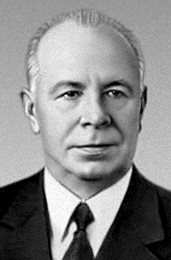
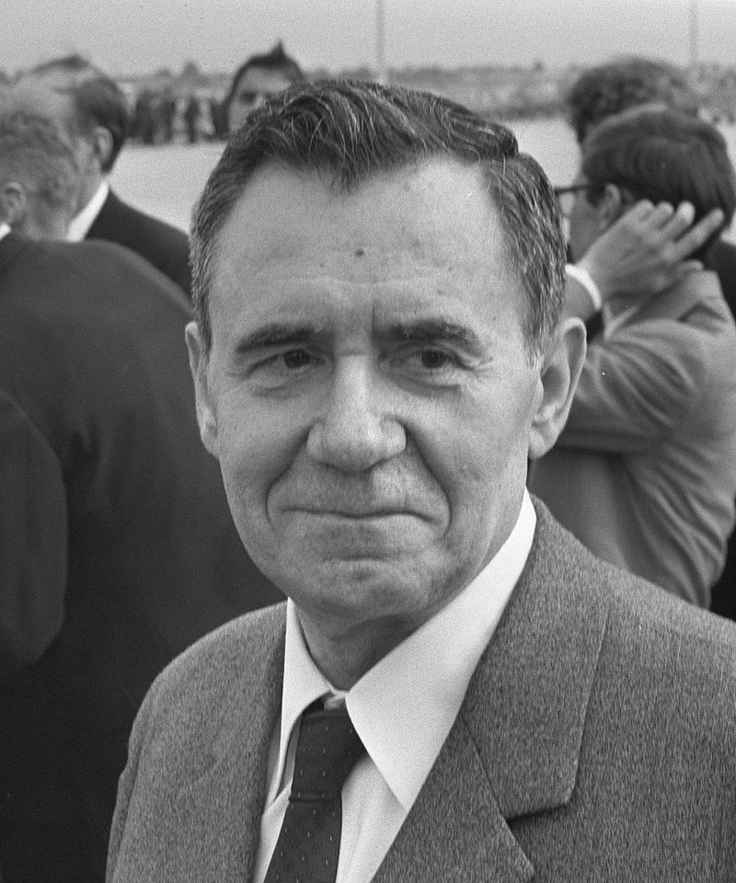
USSR
Executives during 1971
PRESIDENT OF UNION OF SOVIET SOCIALIST REPUBLICS
Foreign Minister
Nikolai Podgorny
Andrei Gromyco

Slide 12
First Phase of Soviet Policy
(March-June)
On 24th Congress of Communist Party, Leonid Brezhnev asked for political solution on the basis of maintaining the interest of the people of ‘East Bengal’
On 2nd April, President Podgorny urged Yahyah Khan to stop repressive activities and bloodshed to seek a peaceful way for East Pakistan crisis in a letter.
In an official visit to Moscow, Sharan Singh asked for becoming more active in Bangladesh issue.

Slide 13
Second Phase of Soviet Policy
(July-November
China Visit of Kissinger- Kissinger visited China and Pakistan on 9-10th July and declared that China will interfere if India will attack Pakistan and USA mayn’t help India in such case.
Indo-Soviet Friendship Treaty- This treaty was signed on 9th august, 1971. Pakistan got a huge blow from Soviet Union when this treaty was signed as prior to the treaty USSR was confined only into statements and speeches to defame the genocide in Bangladesh and finally USSR adopted a strong pro-India policy in lieu of seeking peaceful solution. On 27-29th September when Indira Gandhi paid a visit to Moscow, the relation between the two nation was consolidated in a way that the joint collaboration of India and USSR protested any solution to the crisis which went against the interest of the ‘Bengali’ people.

Slide 14
Third Phase of Soviet Policy
(December-Till Independence)
As Pakistan failed to address Bangladesh Crisis peacefully and righteously, Soviet Union supported the Indian perspective of direct involvement in the war.
When the Final war started on 3rd december, USSR directly blamed Pakistan for it. Russia was also trying to escape from huge involvement in any war, although supporting ethically and diplomatically in UN and outside UN.
In the last phase, USSR again given a proposal to hand over power to the elected representatives of Awami League but Pakistan also refused this proposal.
When the war reached into its peak point, USSR was trying to procrastinate the proposal of cease fire as if Indian forces will get enough time and space for a military solution of the crisis. Even 0n 7th December, USSR again vetoed to the proposal of cease fire in general assembly.
When the ally forces occupied Dhaka and Pakistan surrendered at 16th December, USSR didn’t put any barrier for the proposal of cease fire in 21st december.

Slide 15
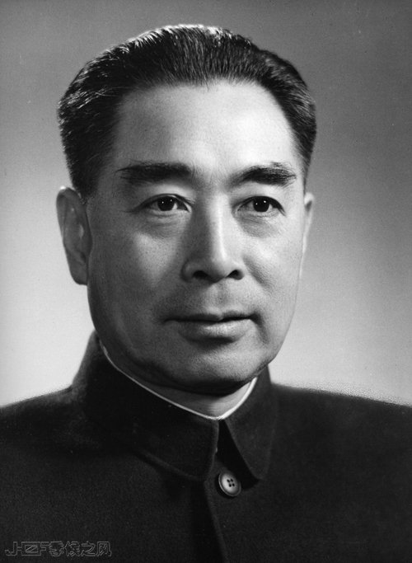
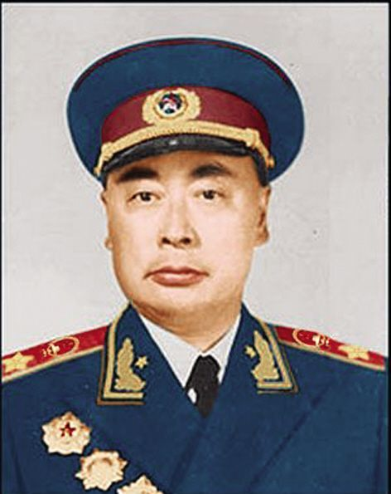
CHINA
Executives during 1971
PRESIDENT OF THE PEOPLES REPUBLIC OF CHINA
Foreign Minister
Zhou en Lai
Chen Yi

Slide 16
First Phase Chinese Policy
(April-November)
11 days later on 11th April, Chinese government showed official reaction for the first time in letter written to Yahya Khan from Zhou En Lai defamed the Indian ‘expansionist’ policy and assured that the people of China will always stand on behalf of Pakistan to protect her sovereignty.
China emphasized on the integral unity of both wing for the development of Pakistan and marked the crisis as ‘internal problem’. Bhasani and other groups ( Peking Communists) failed to attain Chinese support. A small part of demoralized Pekingian communists (Bhasani) started armed revolution but rest of them were against the liberation of Bangladesh.
Up to October, Chinese support was provided in a passive way. But China started to play a vital role when Kissinger visited Beijing on july.
In August when India-Russia treaty was signed, It made China frightened and China again assured Pakistan that they will protect the national sovereignty of Pakistan.
Although Pakistan was requesting relentlessly for a military contract, Beijing didn’t show any interest in the matter.
Through out the First phase, China continued her support both militarily and ethically.

Slide 17
Second Phase of Chinese Policy
(3^{rd-16th} December)
On 5th and 7th December, Russia pushed two proposals for cease fire aiming political solution of the crisis but China vetoed in both proposals.
China supplied huge arms for Pakistan through out the war, after the Liberation, arms recovered from Pak forces showed that 60% from US and 40 % from China.
So Called ‘Friend of Oppressed People’
‘Bangladesh is an output of Russian-Indian Enterprise’

Slide 18
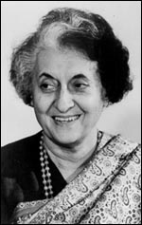
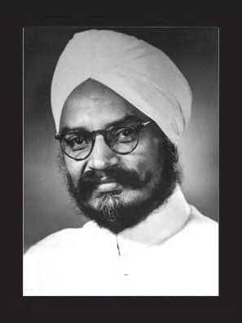
INDIA
Executives during 1971
Prime Minister of India
Foreign Minister
Shreemoti Indira Ghandi
Swaran Singh

Slide 19
First Phase
(April-July)
In the early phase, India wasn’t in favour of providing direct help and declaring war against Pakistan rather they freed the border for refugees, training and political activities.
Within June, the number of refugees reached into 50 lacs
From April onwards, Mujib Bahini was formed upon direct help and patronization from RAW
From June onwards to November, training was continued with the arms and financial support from India
Mujibnagar Government in Exile and Swadhin Bangla Betar
In June, Kissinger requested Indira not to interfere in the ‘internal matter’ of Pakistan in his visit to India. As a result, India realized that the solution must be sought in Indian consideration only.

Slide 20
Second Phase
(August-November)
9th August- Indo-Soviet Treaty of Friendship and Cooperation, Indira Gandhi decided in April that a war was needed to stop the exodus and make millions of Bengali refugees return to their homes. However, the Pakistani leadership was very well connected, as Yahya Khan had a close personal friendship with American president Richard Nixon, and harboured excellent diplomatic relations with Mao's China. Under these circumstances, Indira Gandhi was apprehensive about sending an army to East-Pakistan.
To her relief, the Soviet leadership was open to negotiations. The ensuing Treaty of Friendship and cooperation, signed in August 1971, was very loose but sent a strong signal to Washington and Beijing.
On 23 November, Yayah Khan declared war against India within 10 days

Slide 21
Last Phase
(3rd-16 December)
When Pakistan attacked Indian Air Bases on 3rd December, the final war was thus initiated
On 6th december, India recognized Bangladesh as a sovreign independent country and started a all-pervading attack against Pakistan in air, naval and land ways and entered into Bangladesh.
The Joint forces reached Dhaka on 15th december and Niazi signed the paper of surrender on 16th december.

